Slide 1
Insurance Fraudulent detection
by
k.mohan sri vinay

Slide 2
Business Problem
A major insurance company is witnessing a significant no.of insurance claims turning out to be fraudulent.
So, it is trying to predict the fraudulent claims before the processing of claims in order to better allocation of costs and minimise the leakages.
Predicting the fraudulent claims helps both the insurance company and the society by reducing the money wasted on false claims and thus concentrating on the real claims.
And reporting the fraudulent insurance claims to suitable legal entities is also a responsibility of the insurance company which can be done efficiently by a ml algorithm

Slide 3
ML Problem Statement
In the above statement our duty is to predict whether a reported insurance claim is fraudulent or not.
So, it is a classification problem under supervised learning method with “ReportedFraud” being our target variable.
We can use various ML models for doing this problem and choose th one with

Slide 4
Data Exploration
Data sets:
The individual datasets given before merging are
Demographics data
Policy information
Claim information
Data of Vehicle
Fraud data
In the vehicle dataset it is observed that the vehicle data attributes are given individually to each record or customer.
So, to make computation easier I converted then into columns using “.query” function.

Slide 5
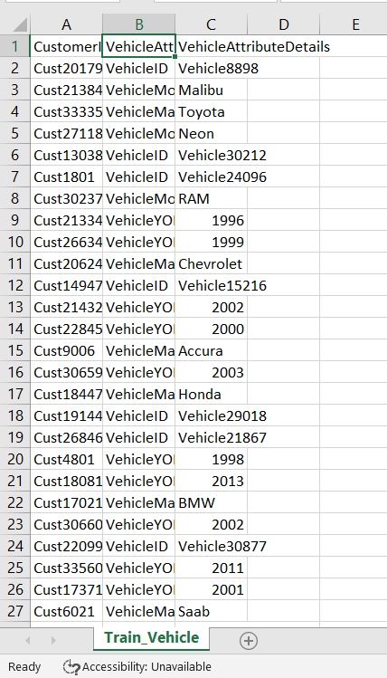
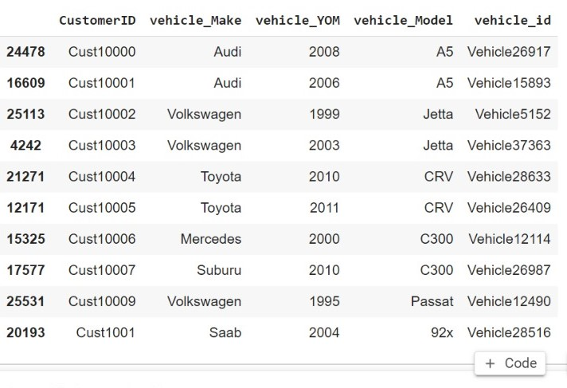
Before using .query function
After using .query function

Slide 6
Merging Data
After that all the individual train and test data sets are merged to get a single unified train dataset and test data set using “pd.merge” function .
As “customerID” is the common attribute in all the data sets we merge using that attribute.
combined_train=train_claim.merge(train_demo, on="CustomerID").merge(train_policy, on="CustomerID").merge(vehicle_train, on="CustomerID").merge(train_target, on="CustomerID")

Slide 7
Pre processing Steps
Synthesizing date columns
Conversion of Datatypes
Null Values Treatment
Dropping Unwanted Columns
Outliers treatment
Standardisation and Dummification
Train-test split
Visualisations

Slide 8
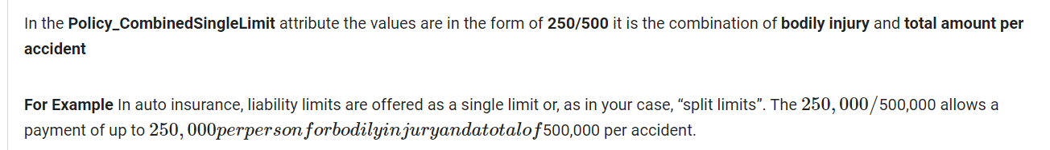
Splitting Date Columns
In the columns “DateOfIncedent” and “DateOfPolicyCoverage” the dates in the format DD/MM/YYYY are split into three columns using lambda split.

Slide 9
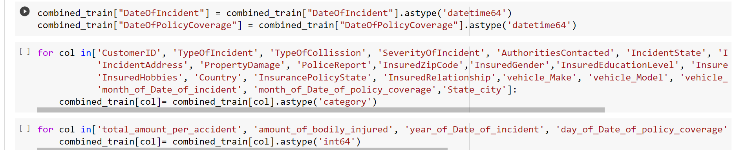
Datatype conversion
The attributes were given their appropriate datatypes i,e to “int” or “category”using astype() command.
And , the attributes “DateOfIncedent” and “DateOfPolicyCoverage” are coverted to dtype datetime64.

Slide 10
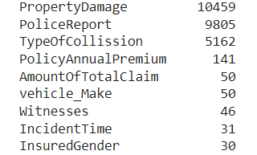
Null value Treatment
After checking for null values in the data it can be seen that
a significant no.of null values are in “TypeOfCollision”,”PoliceReport”
and “PropertyDamage”.
So, imputation is done to replace the null values with respective
Central tendencies of those attributes using “SimpleImputer”.
Next, the no.of unique values in each column are checked using “df.nunique()” command.
And , the columns with a very high no.of unique values like(InsurancePolicyNumber,InsuranceZipcode,Vehicle_id. ..etc) are dropped.
df.drop([“ ”]) command is used for this operation.

Slide 11
Outlier Treatment
Outlier Analysis is done with the help of BoxPlot and it is observed that
policyannualpremium,Umbrellalimit,ammount of total claim,InsuredAge,
CustomerLoyaltyPeriod, consists of outliers.
Instead of removing the outliers we cap them to the upper and lower limit values that can be found from the IQR(InterQuartileRange).
IQR = (combined_train_final['PolicyAnnualPremium']).quantile(0.75) - (combined_train_final['PolicyAnnualPremium']).quantile(0.25)
Upper_limit = (combined_train_final['PolicyAnnualPremium']).quantile(0.75) + IQR*1.5
lower_limit = (combined_train_final['PolicyAnnualPremium']).quantile(0.25) - IQR*1.5
combined_train_final['PolicyAnnualPremium']= np.where(combined_train_final['PolicyAnnualPremium']< lower_limit, lower_limit, combined_train_final['PolicyAnnualPremium'])
combined_train_final['PolicyAnnualPremium']= np.where(combined_train_final['PolicyAnnualPremium']> Upper_limit, Upper_limit, combined_train_final['PolicyAnnualPremium'])

Slide 12
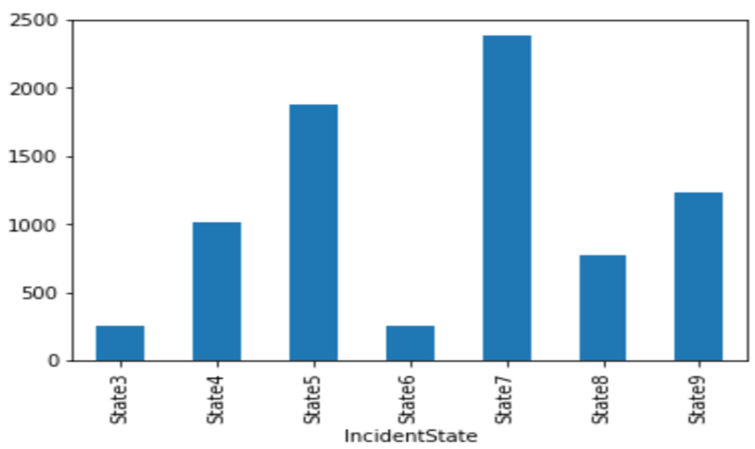
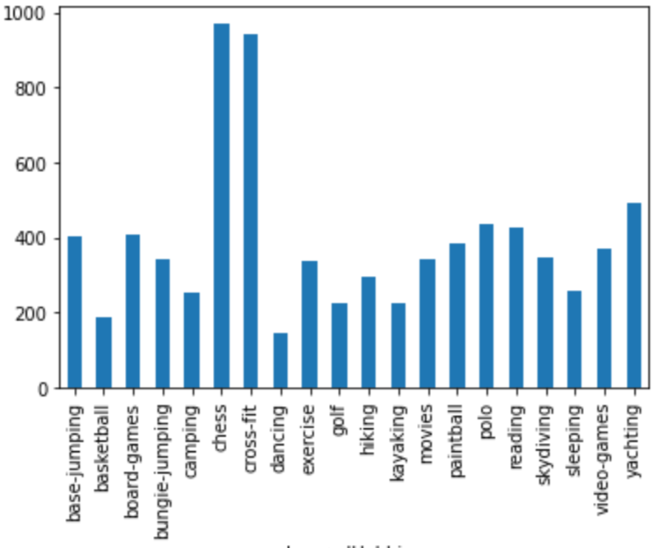
Visualisations
A countplot of fraud_yes and incident state
From this plot we can identify which state
has more fraudulent claims.
A countplot of fraud_yes and Insuredhobbies.
From this plot we can identify what are the hobbies with high fraudulent claims.

Slide 13
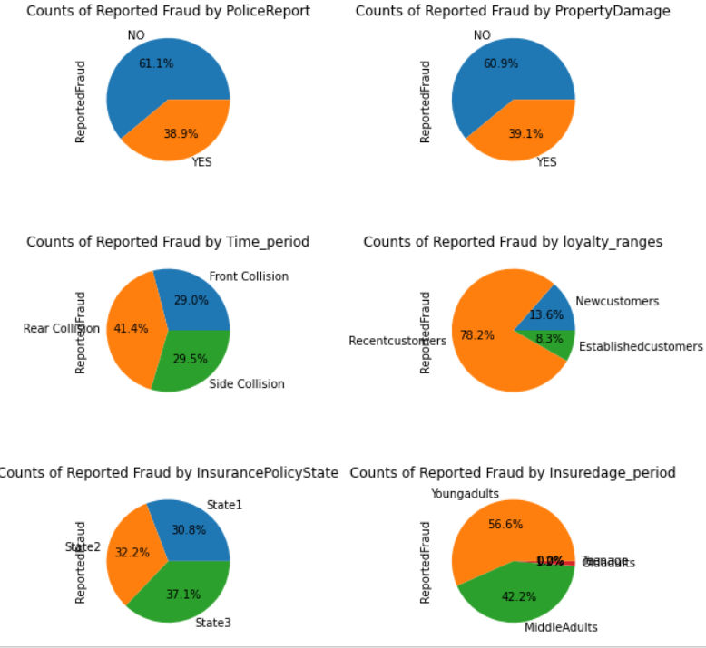
Visualisations
The count plots of “ReportedFraud” vs various attributes like “PoliceReport” , “PropertyDamage”, “Time_period” etc are as follows.
From the above graphs we can see that 61.1% of reported fraud cases has no police report.
Young adults raise more fraud claims.
60.9% of reported fraud claims has no property damage.
And Rear collision is more prevalent in fraud claims.

Slide 14
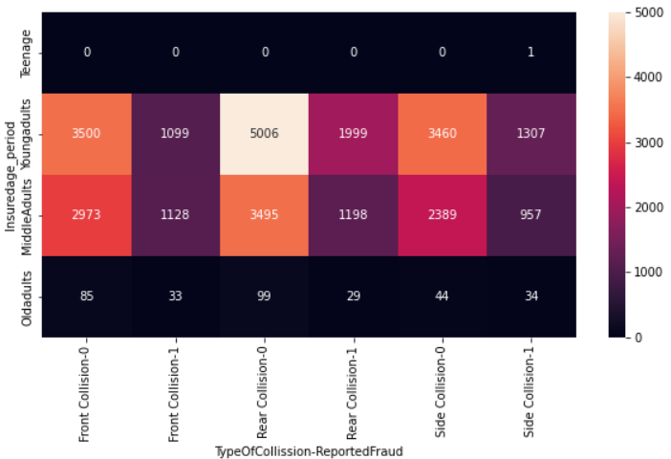
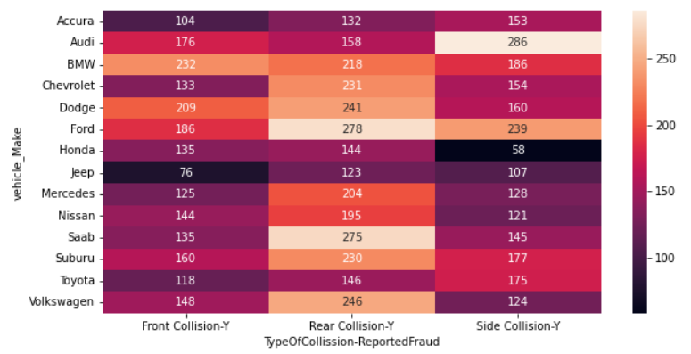
Visualisations
From the below graph it can be seen that MiddleAdults has more no.of fraud claims that the rest of the age groups.
From the below graph we can see the type of collisions different car models experienced.

Slide 15
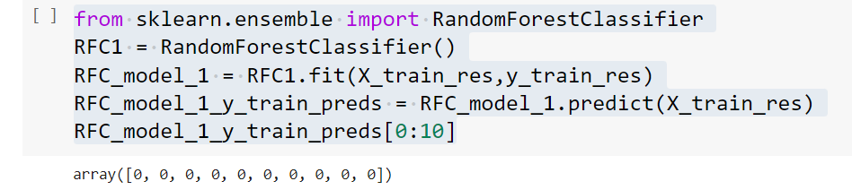
Models
Random forest:
Random forest model is built and train and test data is passed.
Predictions are made for the data and the respective f1_scores are as follows:
f1_score for train data: 1.0
F1_score for test data: 0.8669097538742023

Slide 16
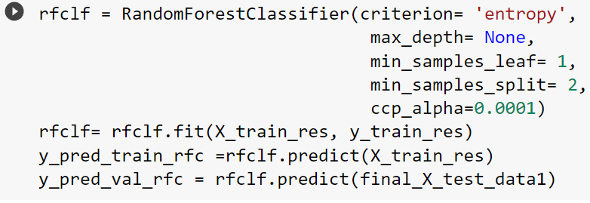
Models
RandomForest model with Tuning:
Hyper parameter tuning is done for the betterment of the model.
Hyper Parameters used are : criterion , max_depth, min_samples_leaf, min_samples_split, ccp_alpha.
f1_score for train data = 0.9815794021081735
f1_score for test data = 0.8690476190476191

Slide 17
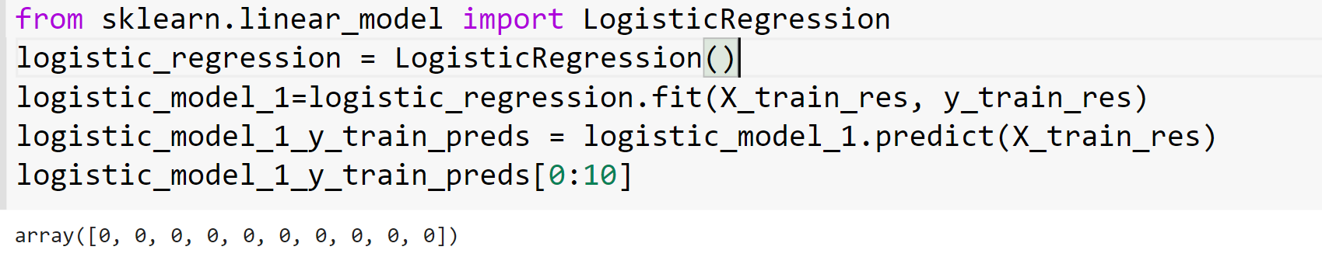
Models
Logistic Regression Model :
A logistic regression model is built and the train and test data is passed to the model.
Predictions for test data are obtained.
Error metric : f1_score
f1_score for train data = 0.9284951214300976
f1_score for test data = 0.869971104689931

Slide 18
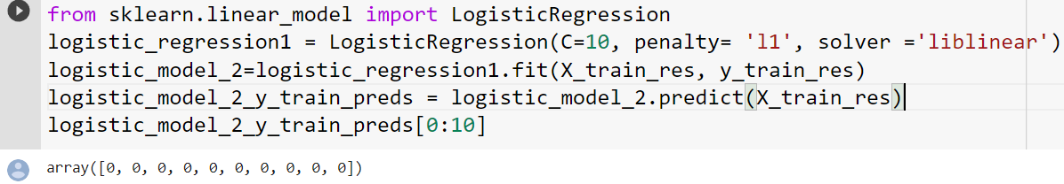
Models
Logistic with Tuning :
The logistic regression model is tuned using hyper parameters for betterment of the model.
Hyper parameters given are : C , penalty, solver.
f1_score for train data = 0.9337120539676904
f1_score for test data = 0.8693913816081741

Slide 19
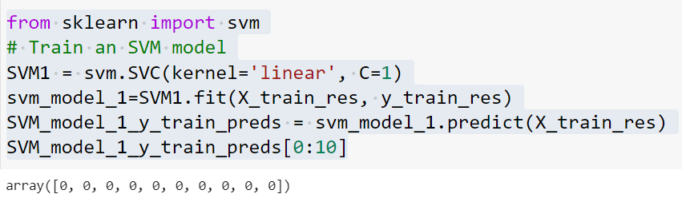
Models
Support Vector Machine(SVM):
An SVM model is built with smote done. And, data is passed to the model.
f1_score for train data : 0.9248214734273513
f1_score for test data : 0.8878848308312794

Slide 20
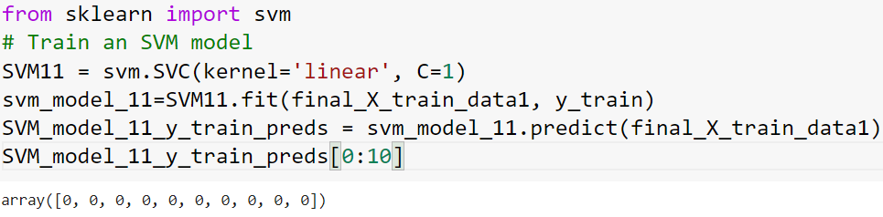
Models
SVM model without smoting:
A SVM model is built and data is passed to it.
The respective f1_scores for train and test data is as follows:
f1_score for train data : 0.8885020791026014
f1_score for test data : 0.8804347826086956

Slide 21
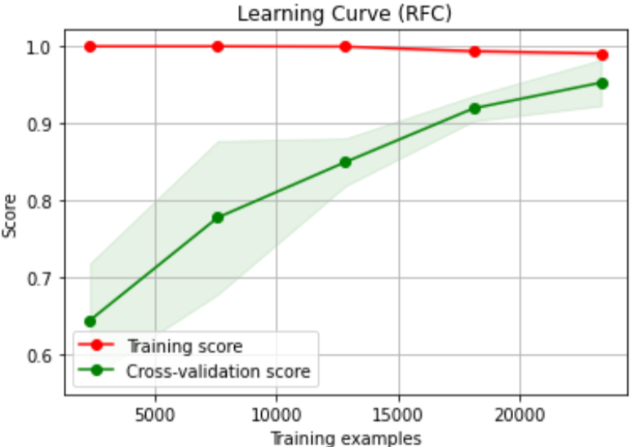
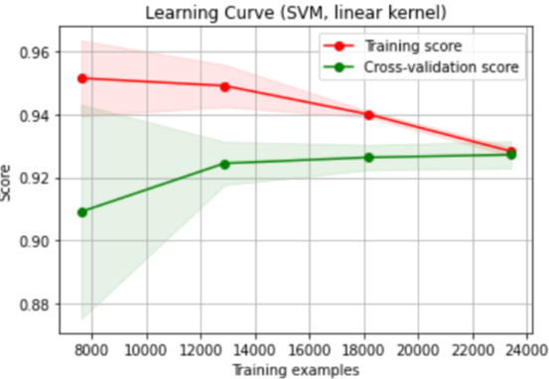
Learning curves
From the learning curve of the random forest model we can see that as the training set increases both the scores converge.
Since the training score is very accurate, this indicates low bias and high variance.
Model results in overfitting.
The learning curve of the SVM model is as above.
We can see that this model is much better compared to random forest with good bias variance tradeoff.

Slide 22
Models performance Overview
Models/ f1scores | Random Forest model | Logistic Regressionwithout tuning | Logistic Regression with tuning | SVM model with smote | SVM model without smote
F1_score (traindata) | 0.9815794021081735 | 0.9284951214300976 | 0.9337120539676904 | 0.9248214734273513 | 0.8885020791026014
F1_score (testdata) | 0.8690476190476191 | 0.869971104689931 | 0.8693913816081741 | 0.8878848308312794 | 0.8804347826086956

Slide 23
Conclusions
From the above graphs it is observed that there are many key details is finding a fraudulent claims:
State3 has high no.of fraudulent claims and young adults is the age group with highest fraudulent claims.
Police report is also important to catch fraud claims as more than 60% of the fraud claims does not have it.
Female Gender has more fraud claims than males and the insurance claims with more severe damage have more chance of being a fraudulent claim.
More fraud claims are present in cases with rear collision.
These are main insights that are derived from the problem.

Slide 24
Suggestions for Business
Company should check whether a police report has been filed or not .
Proper property damage inspection should be done.
Company should focus on situations where a rear collision has happened.
Extra care should be taken while considering the claims of young adults and claims from state3 .

Slide 25
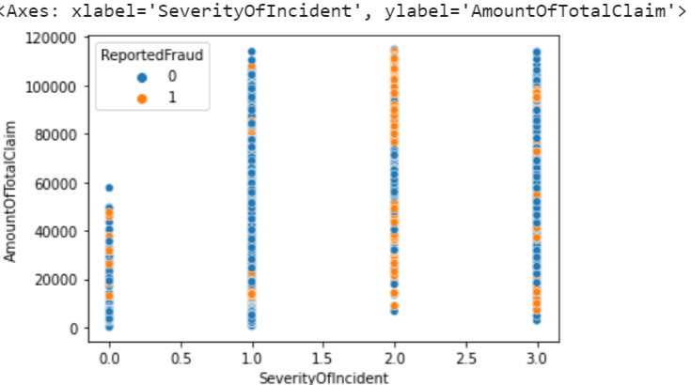
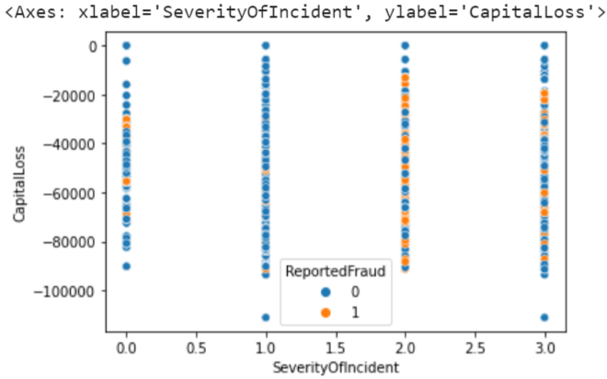
Suggestions
From the above two graphs we can concur that highest number of fraud cases were happend when severity of incident is 2(Major Damage). hence when severity is rated 2 company have to be more careful.

Slide 26
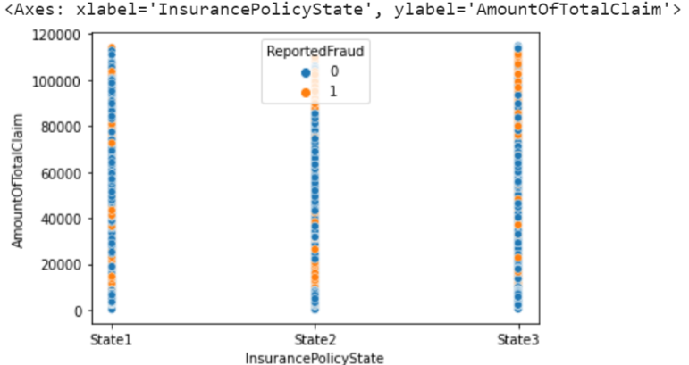
Suggestions
From the graph,
Policies in state2 and state3 should be rechecked for the customers whoever claiming more than 83k

Slide 27
Source Code
Get the full code here - https://github.com/mohan0796/final_hack
Colab file :
https://colab.research.google.com/drive/1DtflzXZKr5fo9qpW4Ttpu3a-ZfPb21dr#scrollTo=oRafUJUiSvYf

Slide 28
Thank you…

